Slide 1
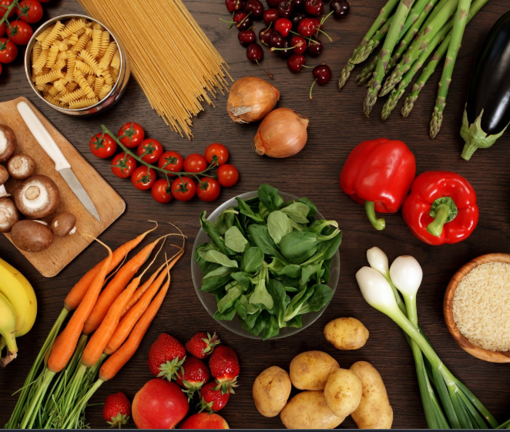
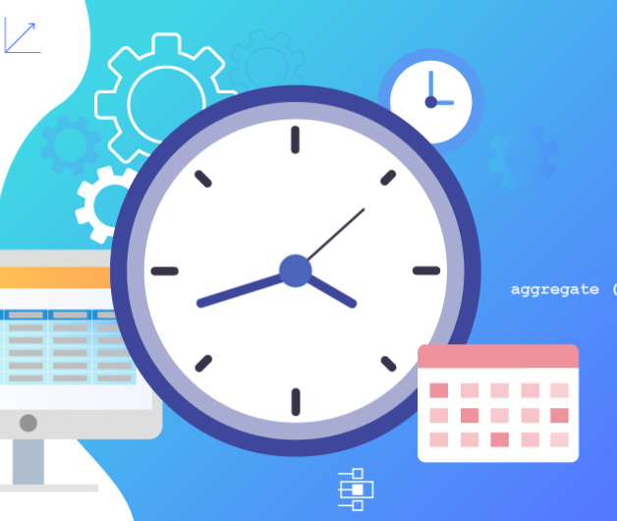
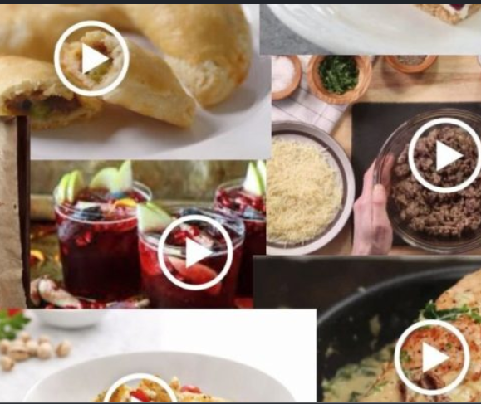
Recipe Matcher
Let's think of situations, when you have some ingredients at home, but you couldn't filter out what exactly you can cook with those ingredients. That's exactly what we have struggled and came up with this idea.
Here when you provide the ingredients to the app its helps you finding the best recipe out of those and estimated time as well.
Avinash Ganguri
Bhashitha Siddareddy
Divya Reddy Bandari

Slide 2
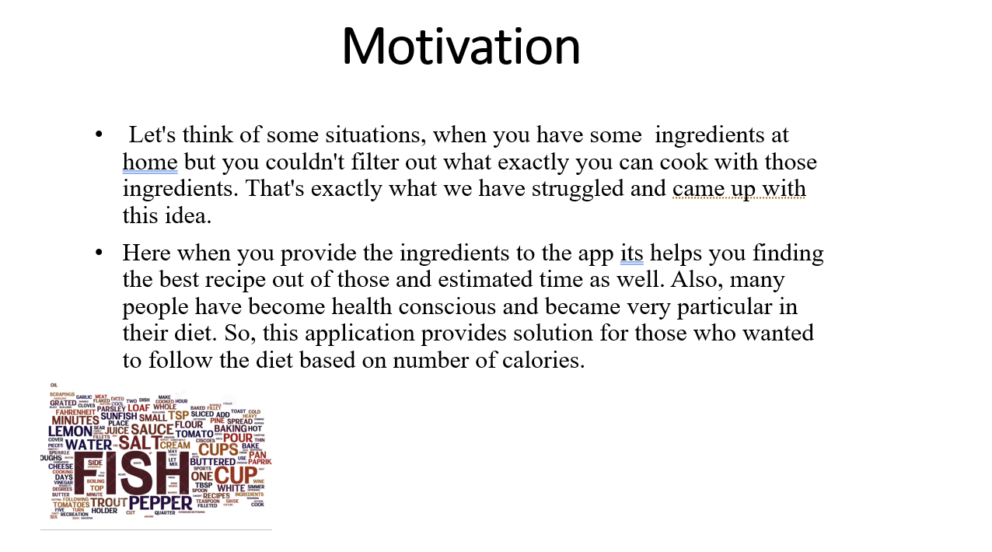

Slide 3
Objective
The main objective is to design an application where the user can login, add ingredients and finds matching recipes.
We have added the camera integration so that our app will be able to recognize the respective food items.
This was done using the IBM Watson Visual Recognition API

Slide 4


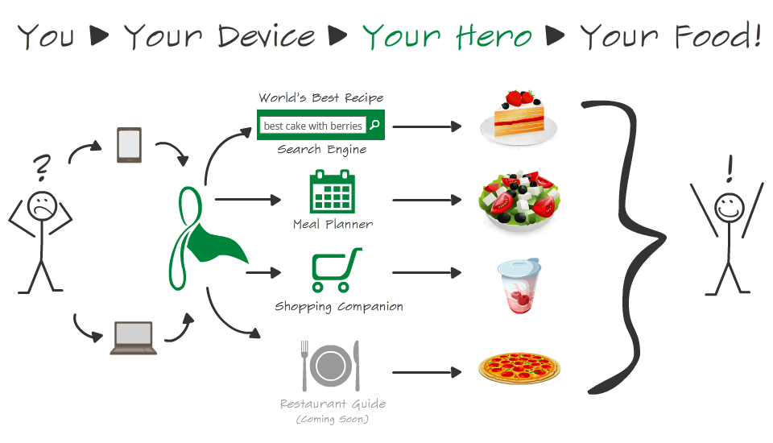
Data Source
Edamam API
Spoonacular API

Slide 5
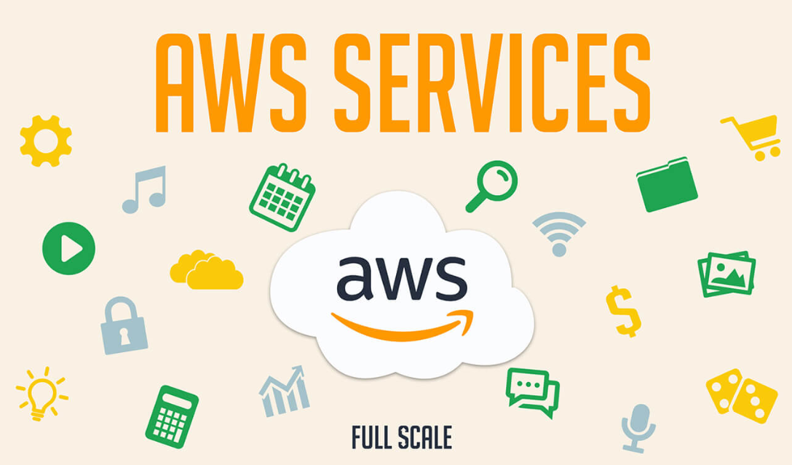
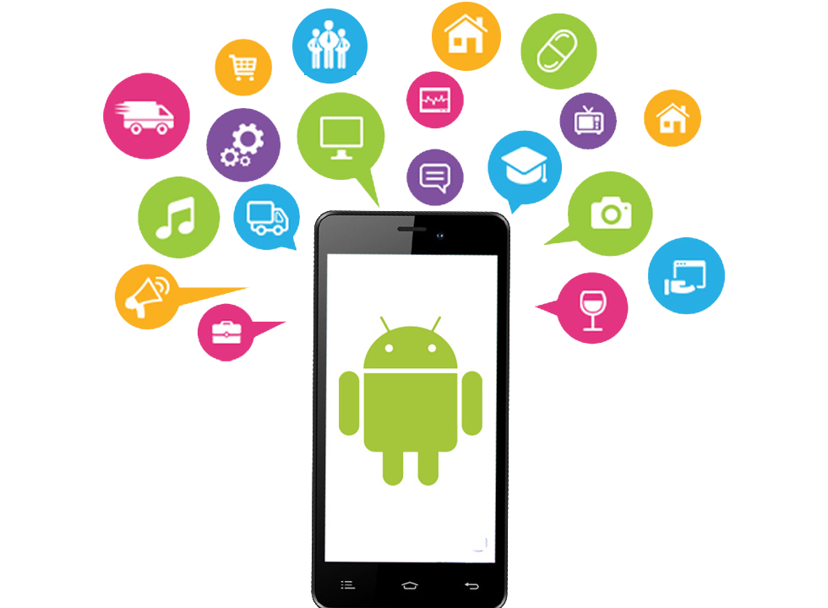
Tools
AWS
Android
Firebase

Slide 6
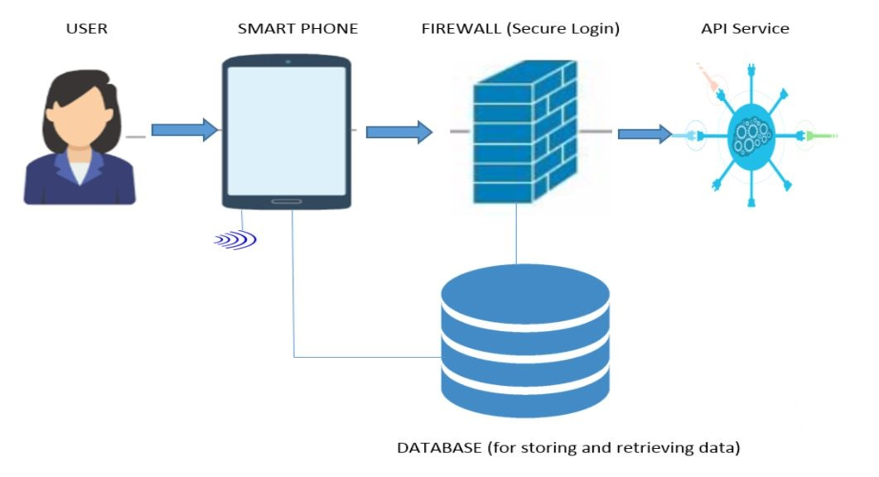
System Architecture

Slide 7
Development Plan
Mid-progress project presentation: We would like to complete the android application and then focus on remaining part.
Final presentation: For the final increment we would like to complete the whole application

Slide 8


